Slide 1


TSP: Temporally-Sensitive Pretraining of Video Encoders for Localization Tasks
Humam Alwassel, Silvio Giancola, Bernard Ghanem
King Abdullah University of Science and Technology (KAUST)
http://www.humamalwassel.com/publication/tsp/
ICCV2021 Workshop on AI for Creative Video Editing and Understanding

Slide 2
Motivation
Video feature extractors used for localization tasks are
pretrained on Trimmed Action Classification (TAC)

Slide 3
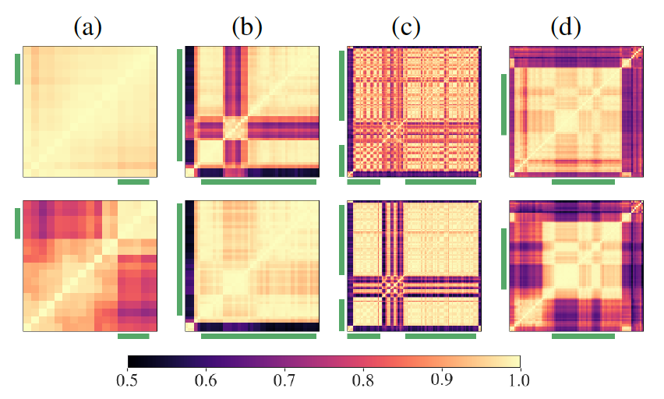
Motivation
Video feature extractors used for localization tasks are
pretrained on Trimmed Action Classification (TAC)
temporally-insensitive: high similarity between features of background (no action) and foreground (action) clips from the same untrimmed video.

Slide 4
Motivation
Video feature extractors used for localization tasks are
pretrained on Trimmed Action Classification (TAC)
temporally-insensitive: high similarity between features of background (no action) and foreground (action) clips from the same untrimmed video.
sub-optimal for localization tasks

Slide 5
Motivation
Video feature extractors used for localization tasks are
pretrained on Trimmed Action Classification (TAC)
temporally-insensitive: high similarity between features of background (no action) and foreground (action) clips from the same untrimmed video.
sub-optimal for localization tasks
We propose Temporally-Sensitive
Pretraining (TSP)

Slide 6
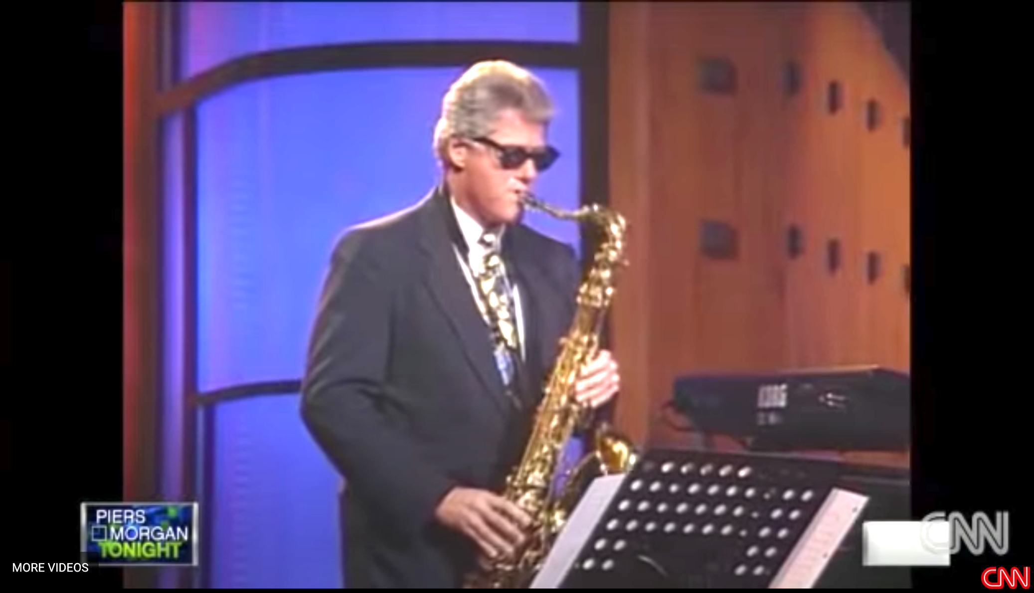
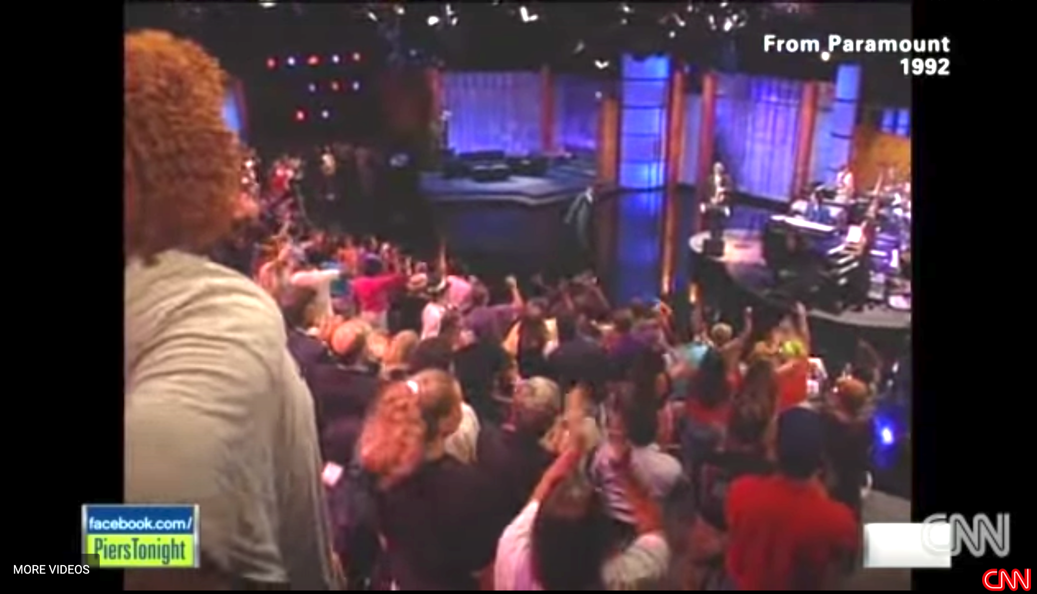
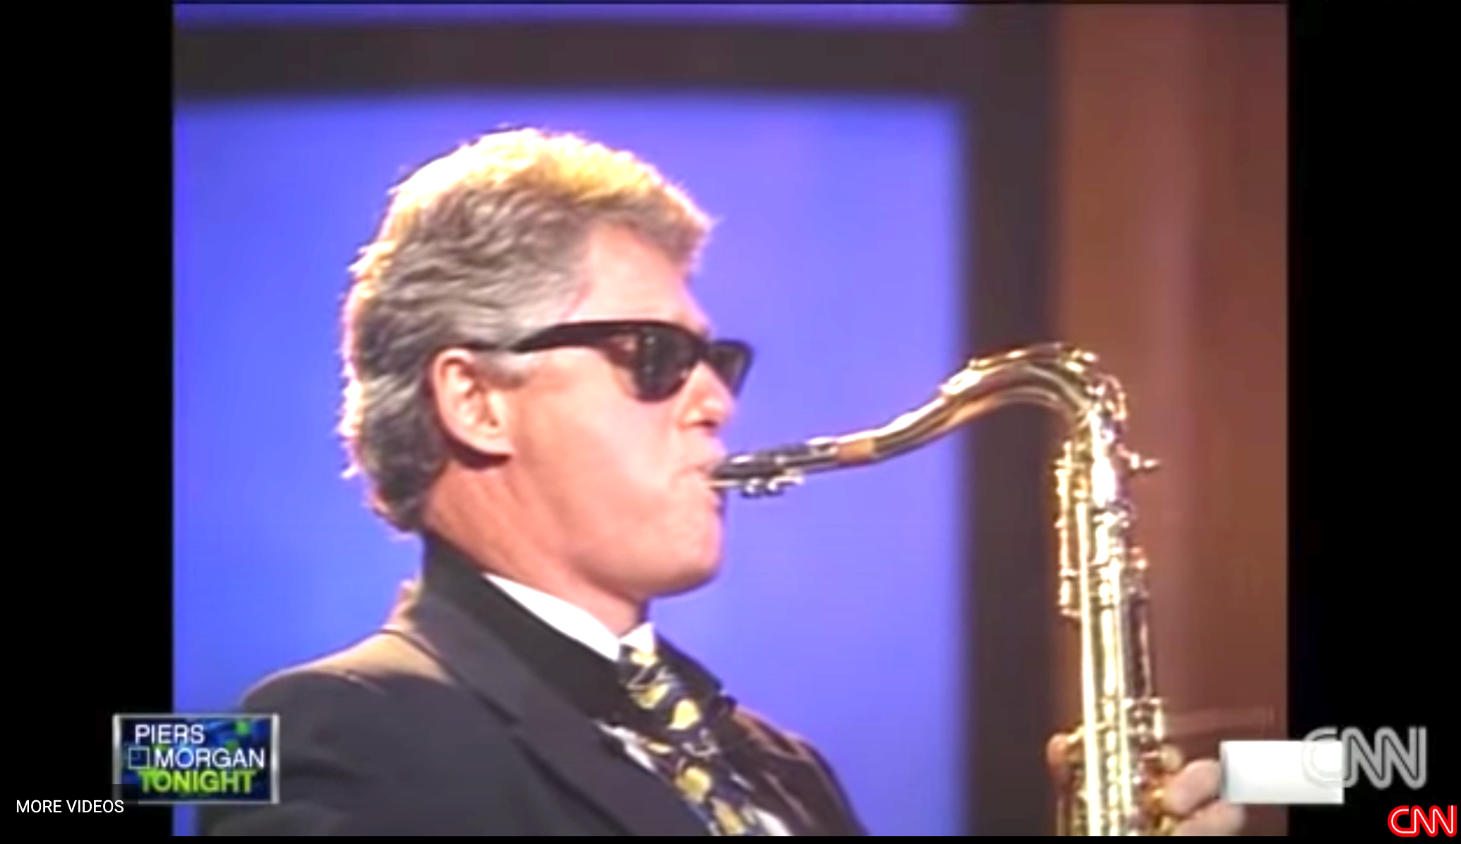
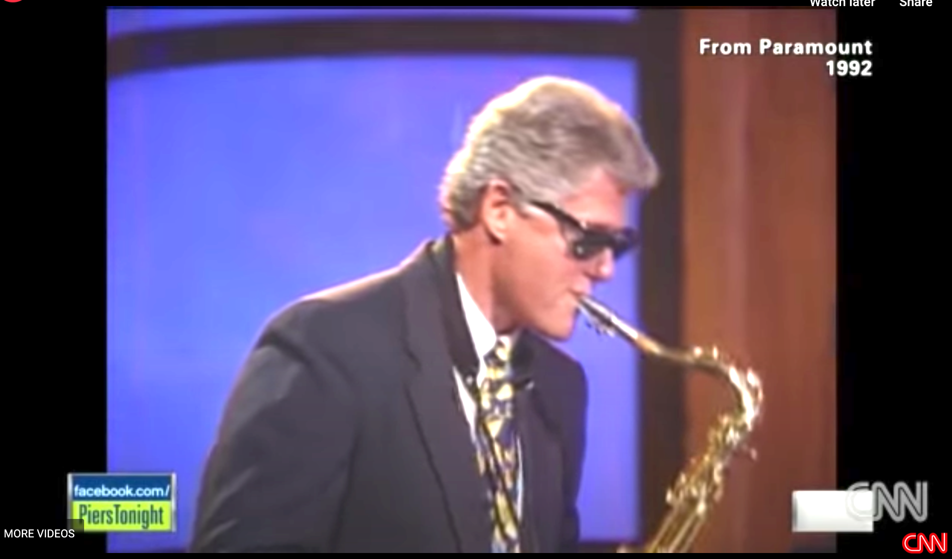


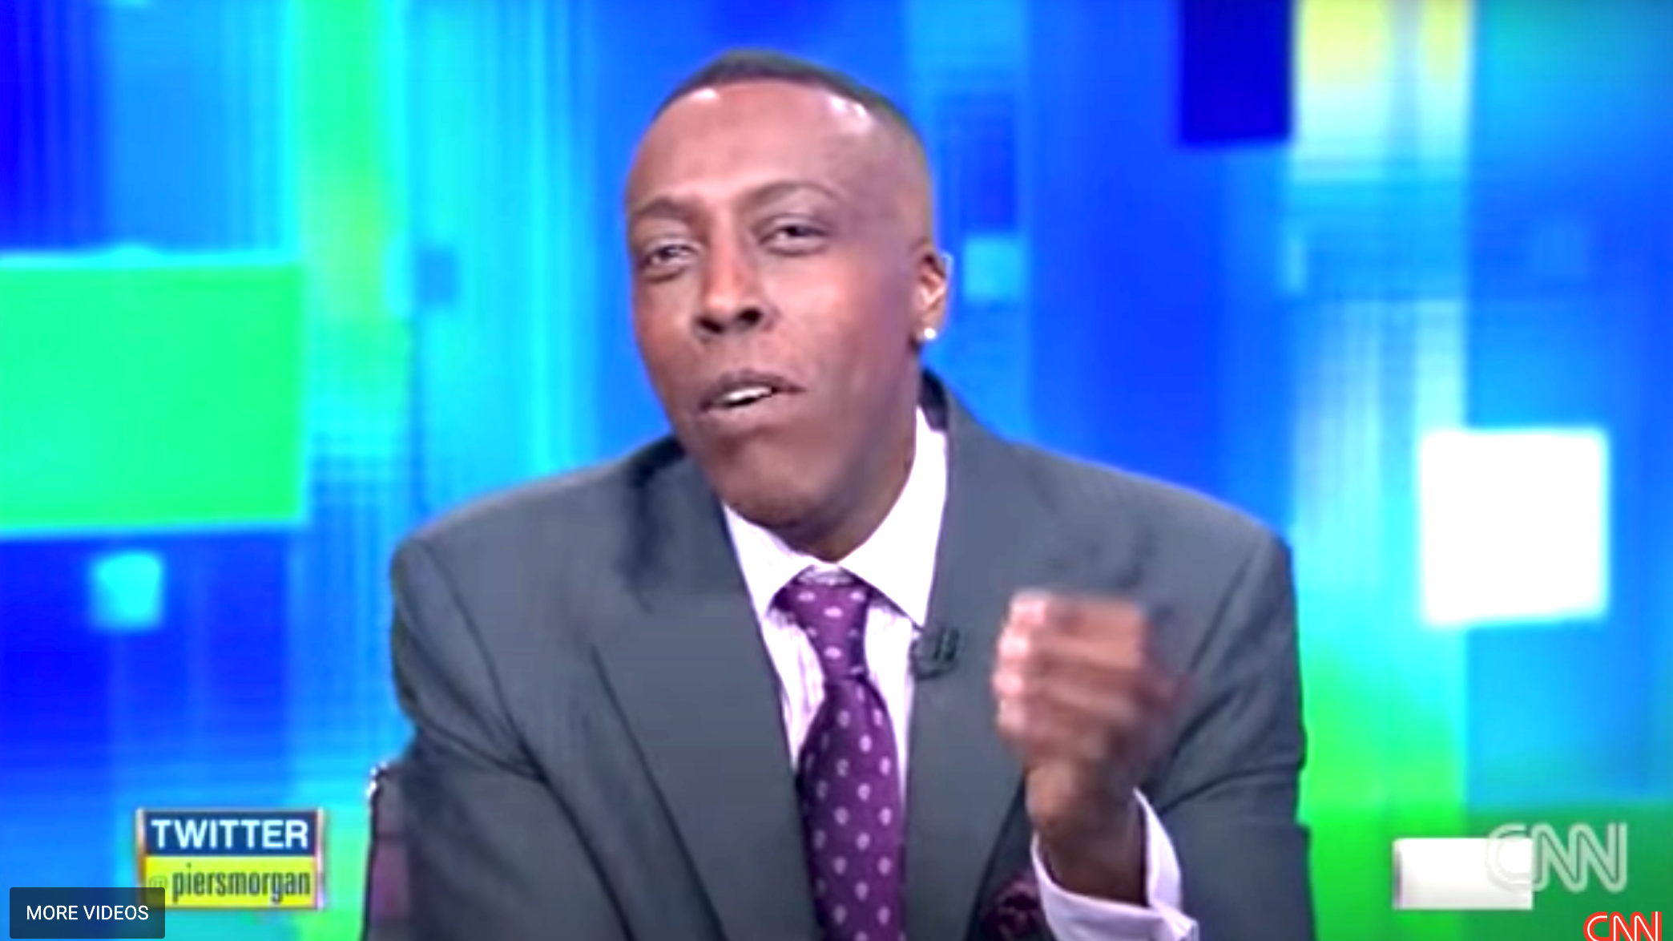
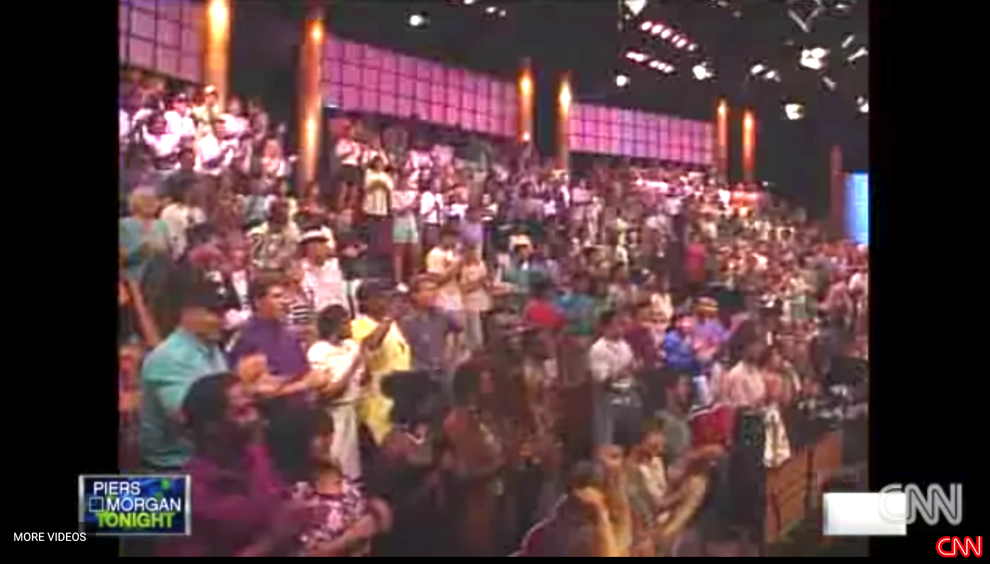

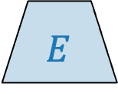
TSP Pipeline
Clip Features
Local Clip Feature
$$f_{ }$$
$$E$$

Slide 7
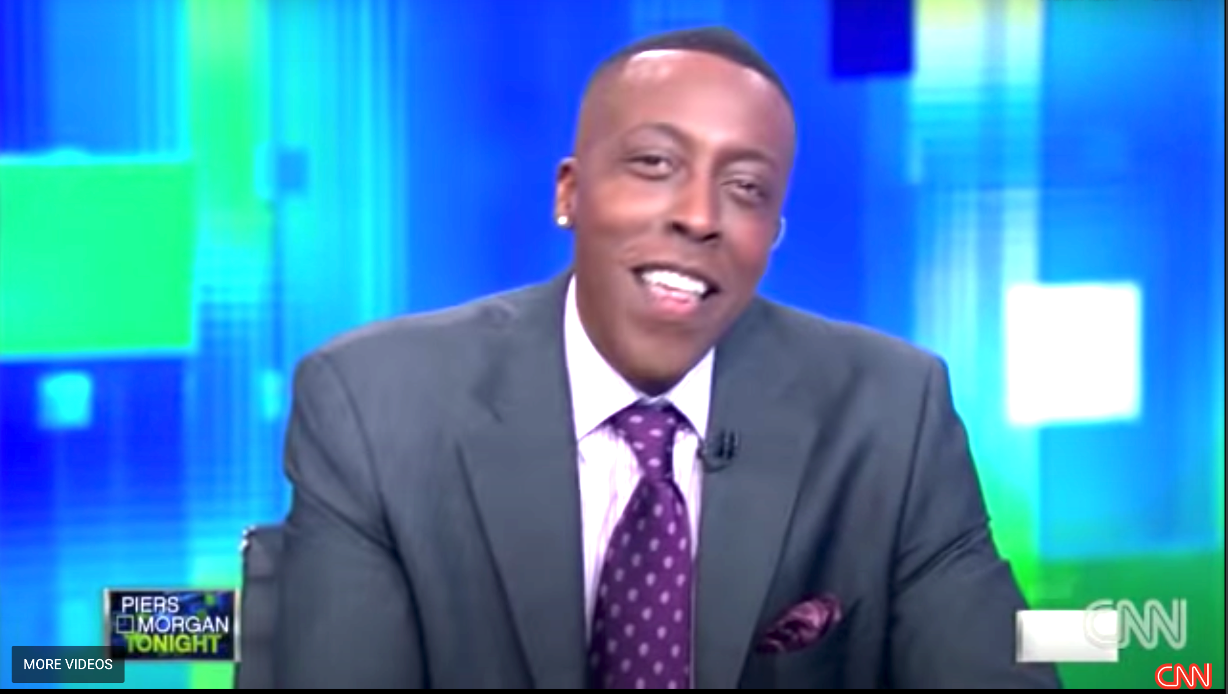
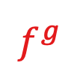
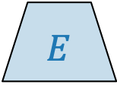

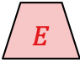


TSP Pipeline
Clip Features
Global Video Feature
Local Clip Feature
$$f_{ }$$
$$f_{ }^{g}$$
Global Video Feature
$$E$$
pool
$$E$$
$$E$$
$$E$$

Slide 8
TSP Pipeline
Action Label Classification
…
Clip Features
Global Video Feature
Action Label Classification:
Activity classes
Local Clip Feature
$$f_{ }$$
$$f_{ }^{g}$$
Global Video Feature
$$E$$
pool
$$E$$
$$E$$
$$E$$

Slide 9
TSP Pipeline
Action Label Classification
Temporal Region Classification
…
Clip Features
Global Video Feature
Action Label Classification:
Activity classes
Temporal Region Classification:
Foreground (action)
Background (no action)
Local Clip Feature
$$f_{ }$$
concat
$$f_{ }^{g}$$
Global Video Feature
$$E$$
pool
$$E$$
$$E$$
$$E$$

Slide 10
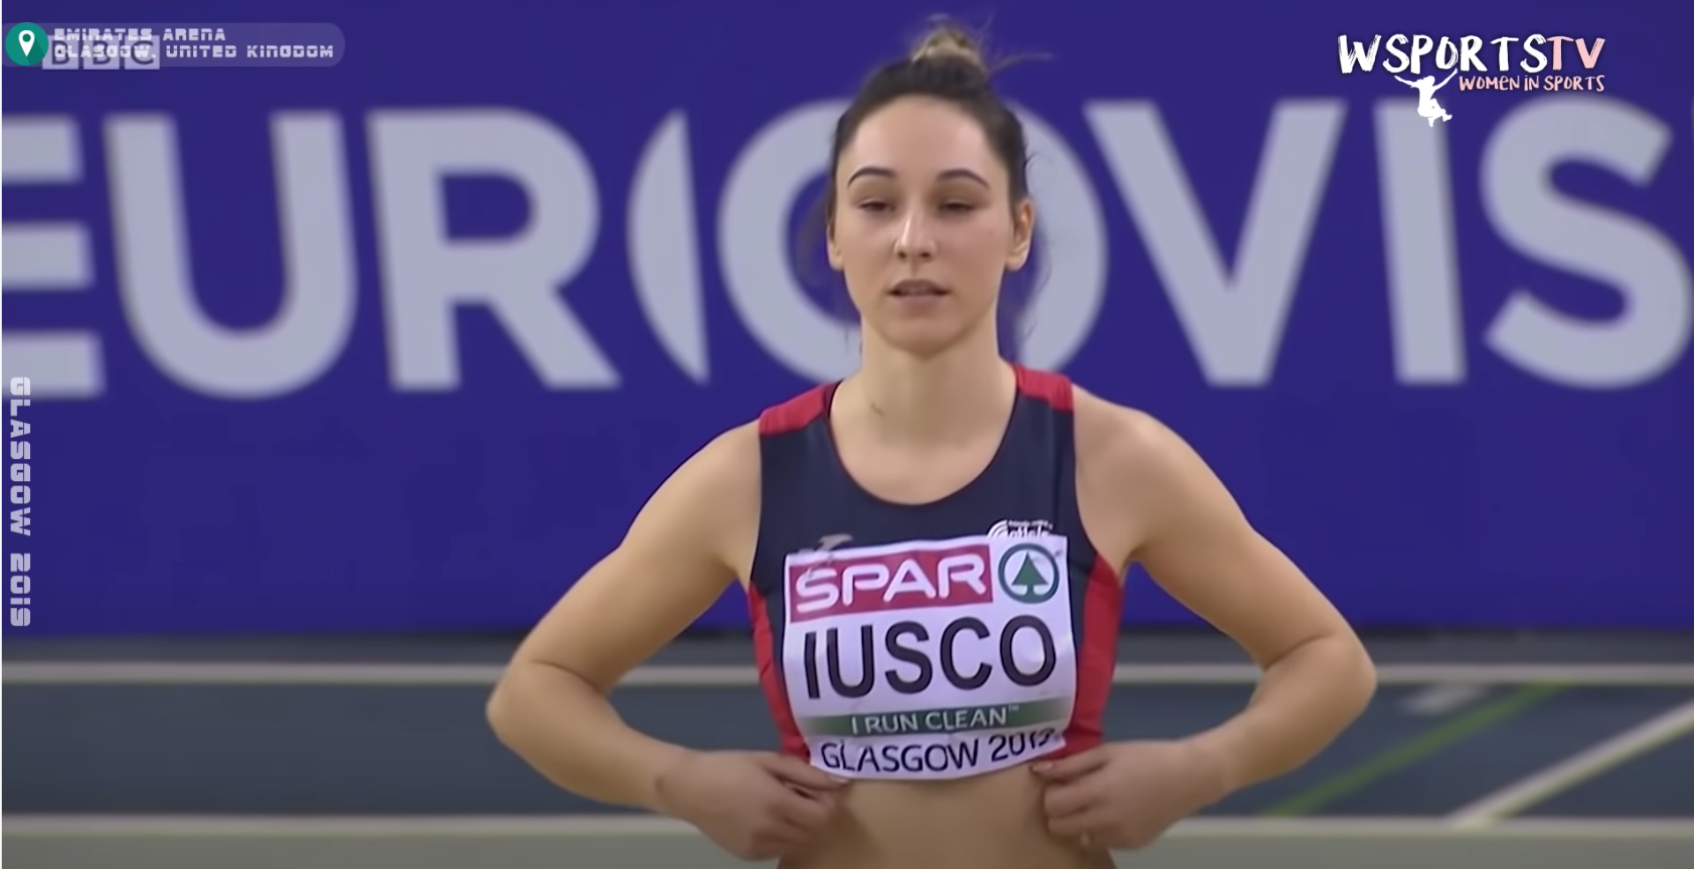
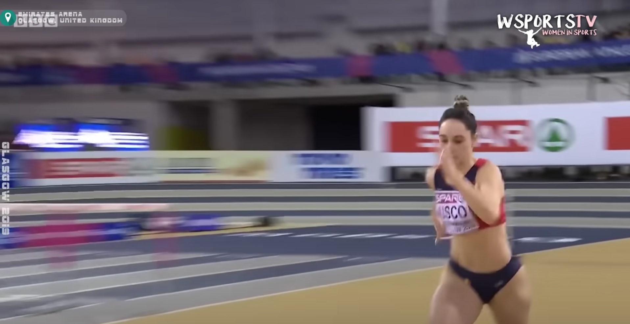
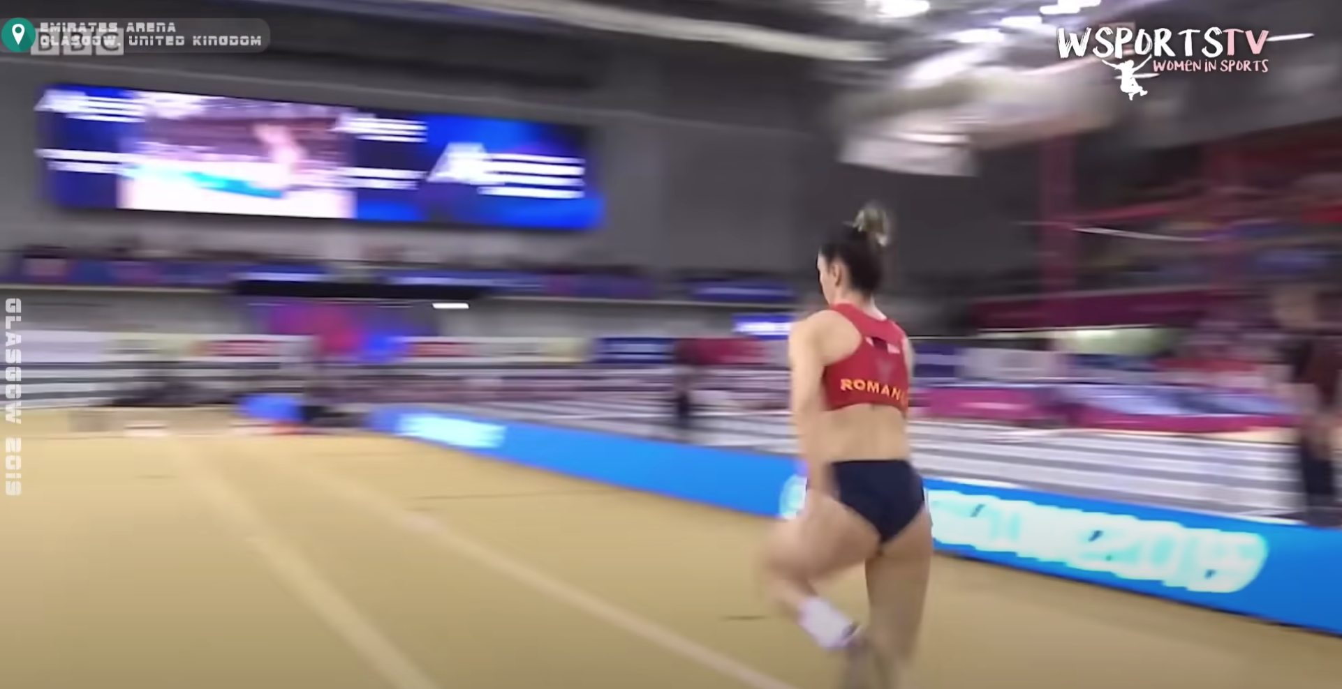
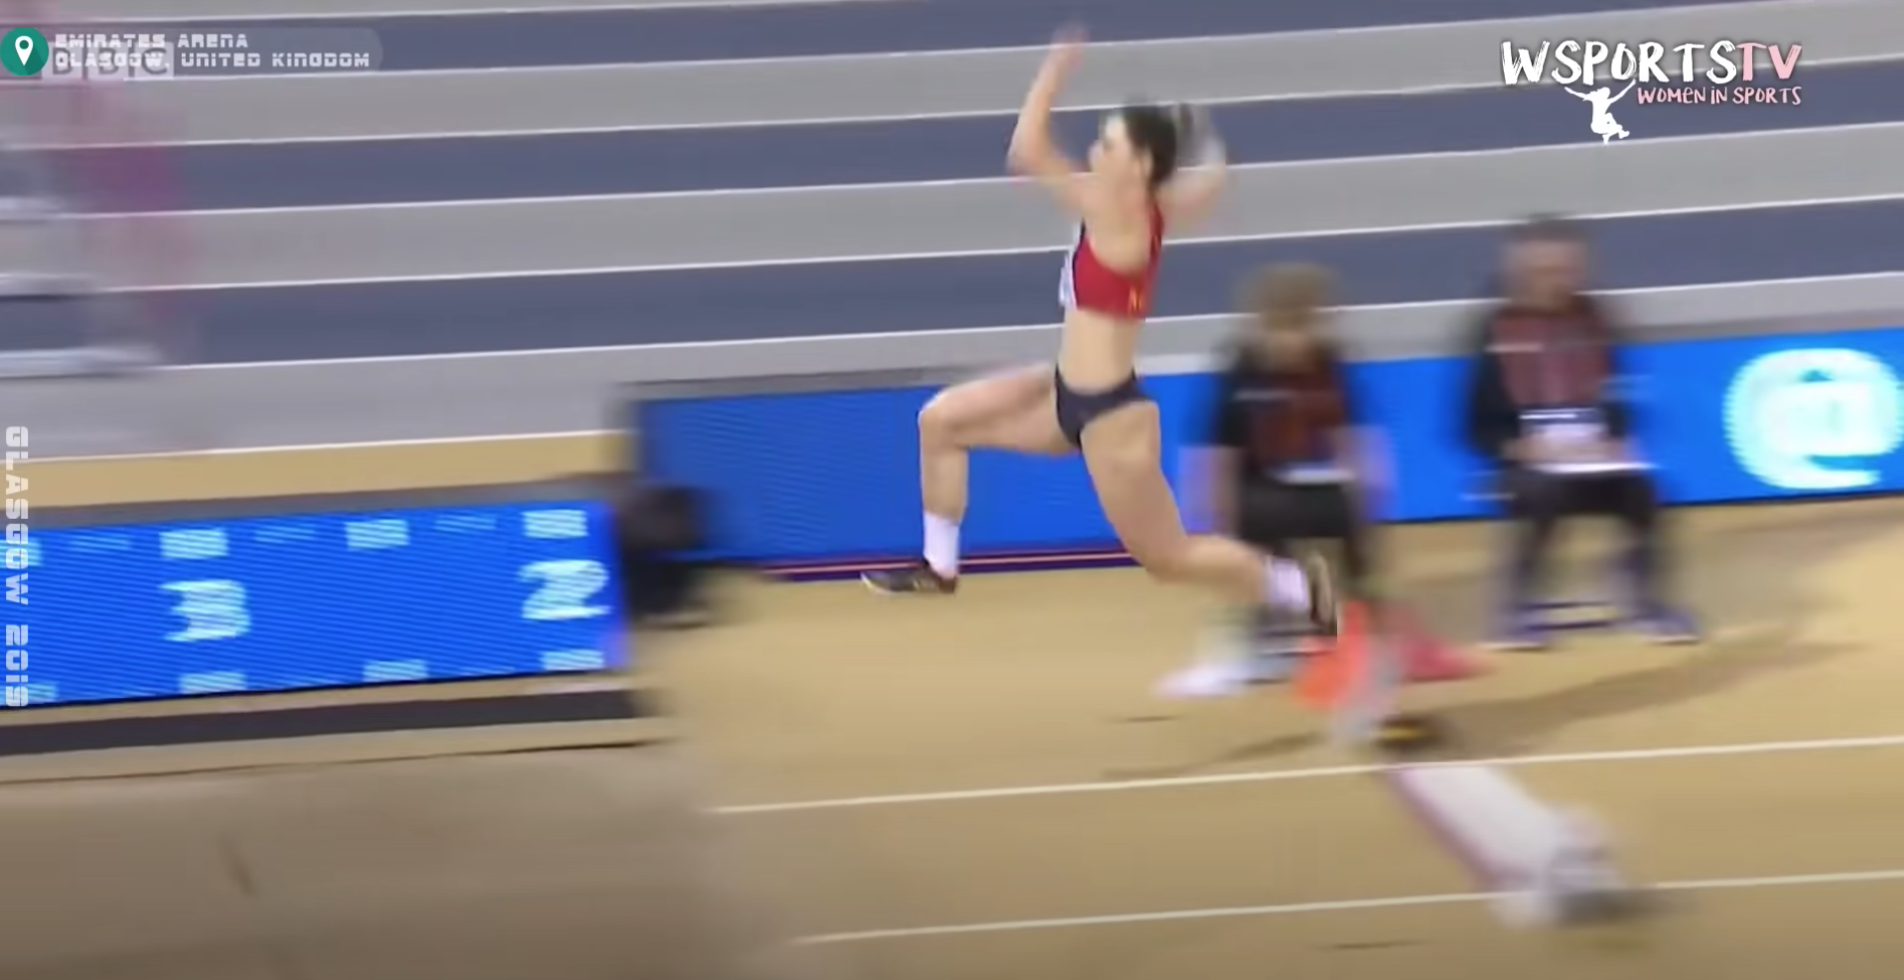
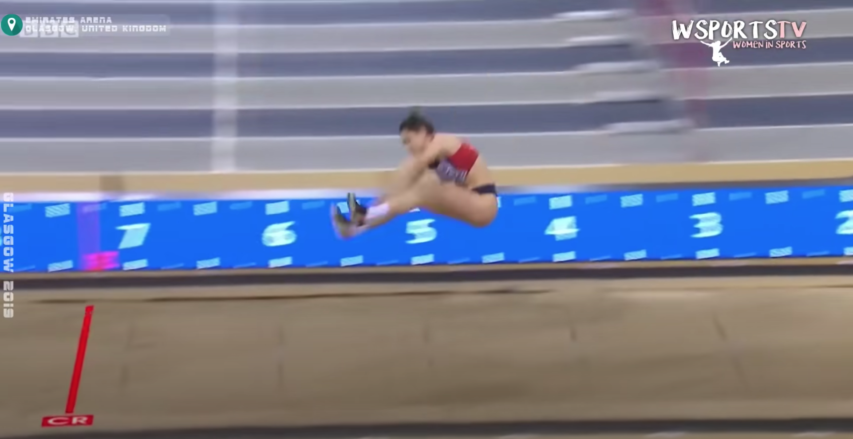
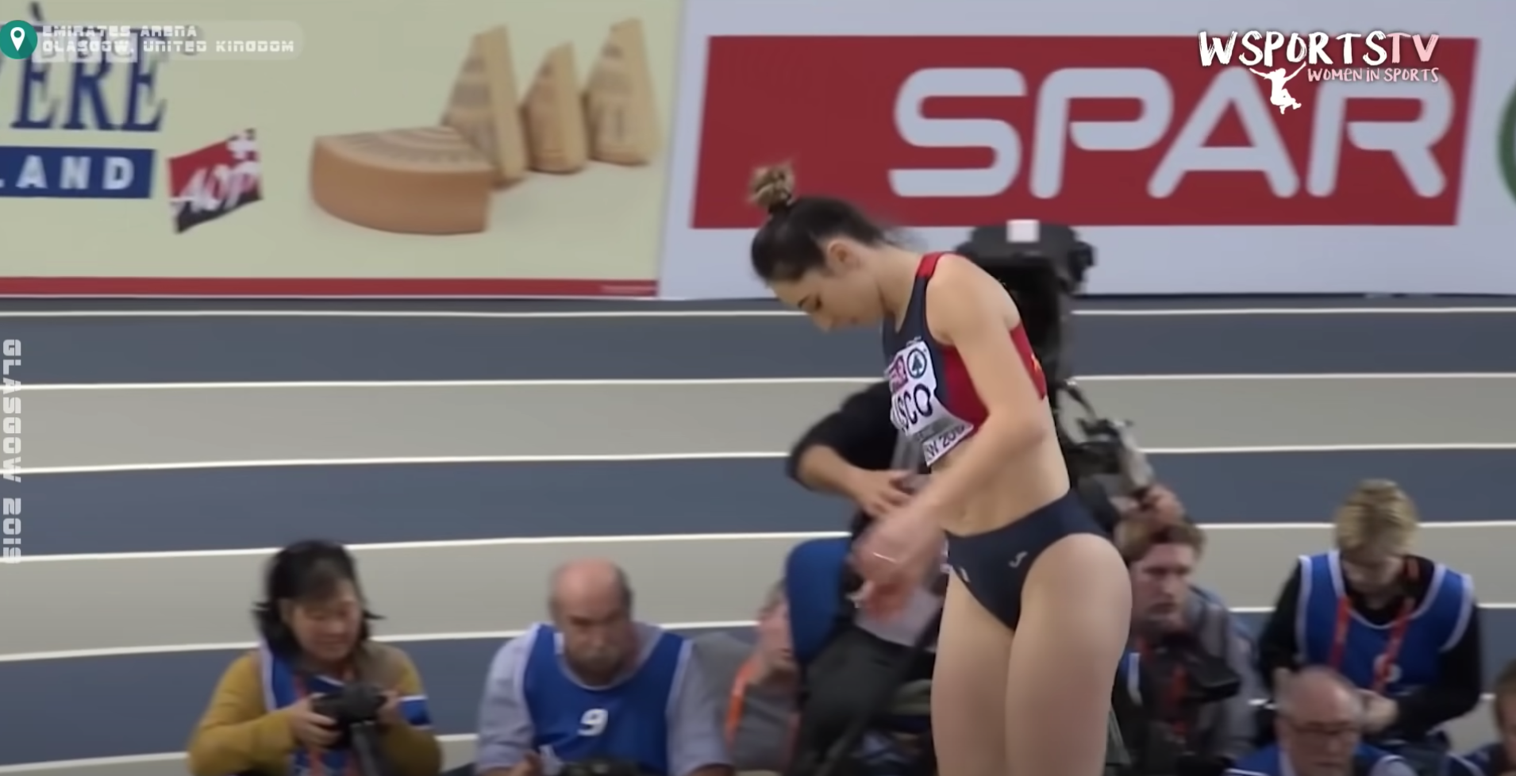
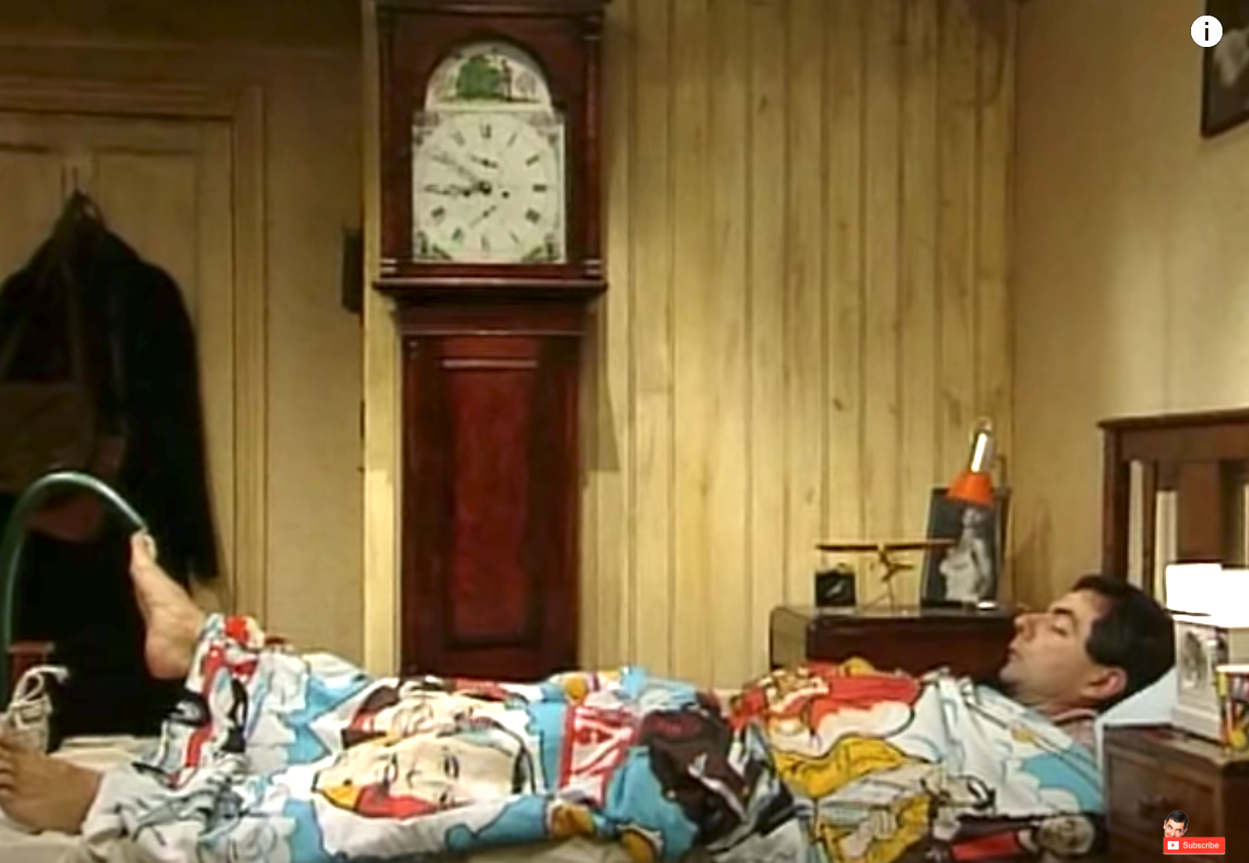
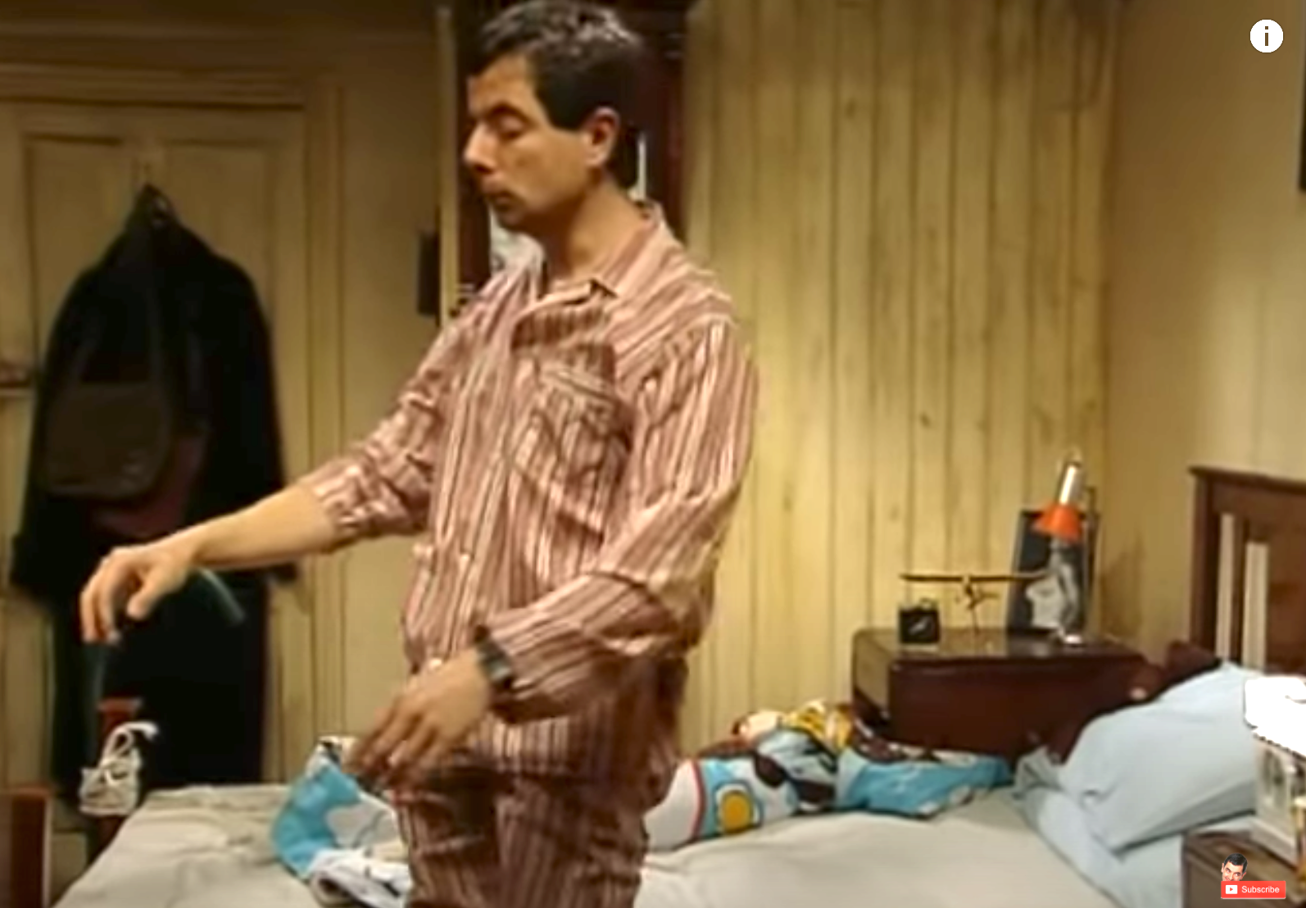
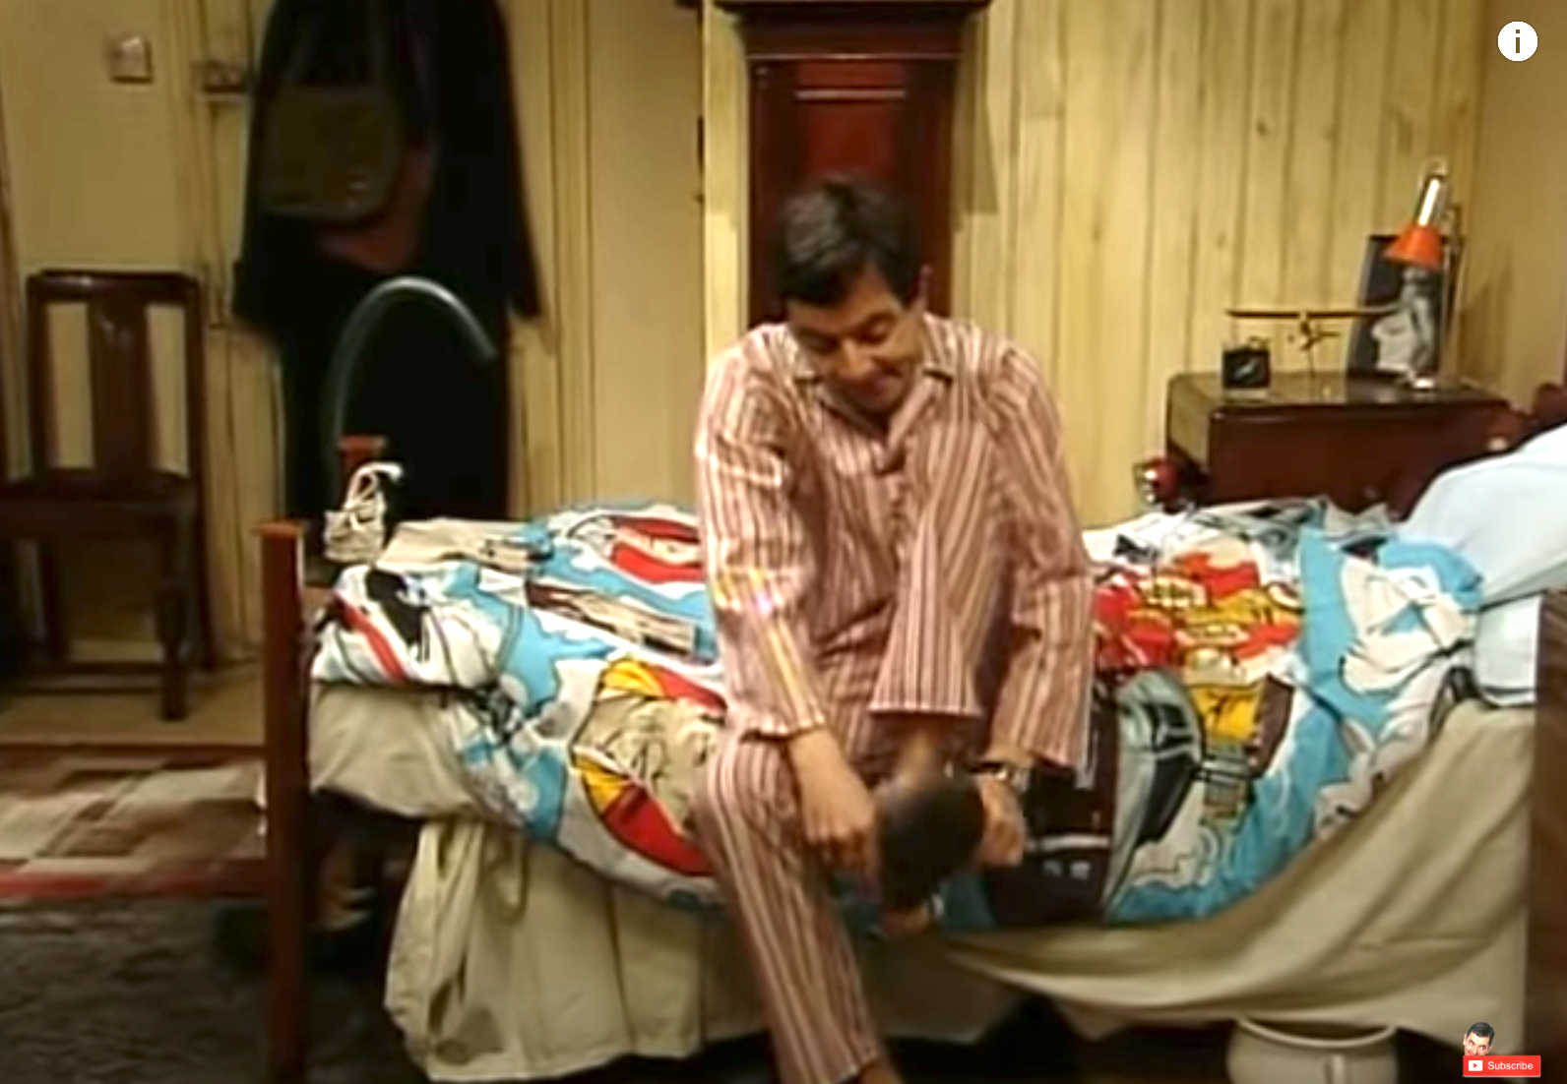
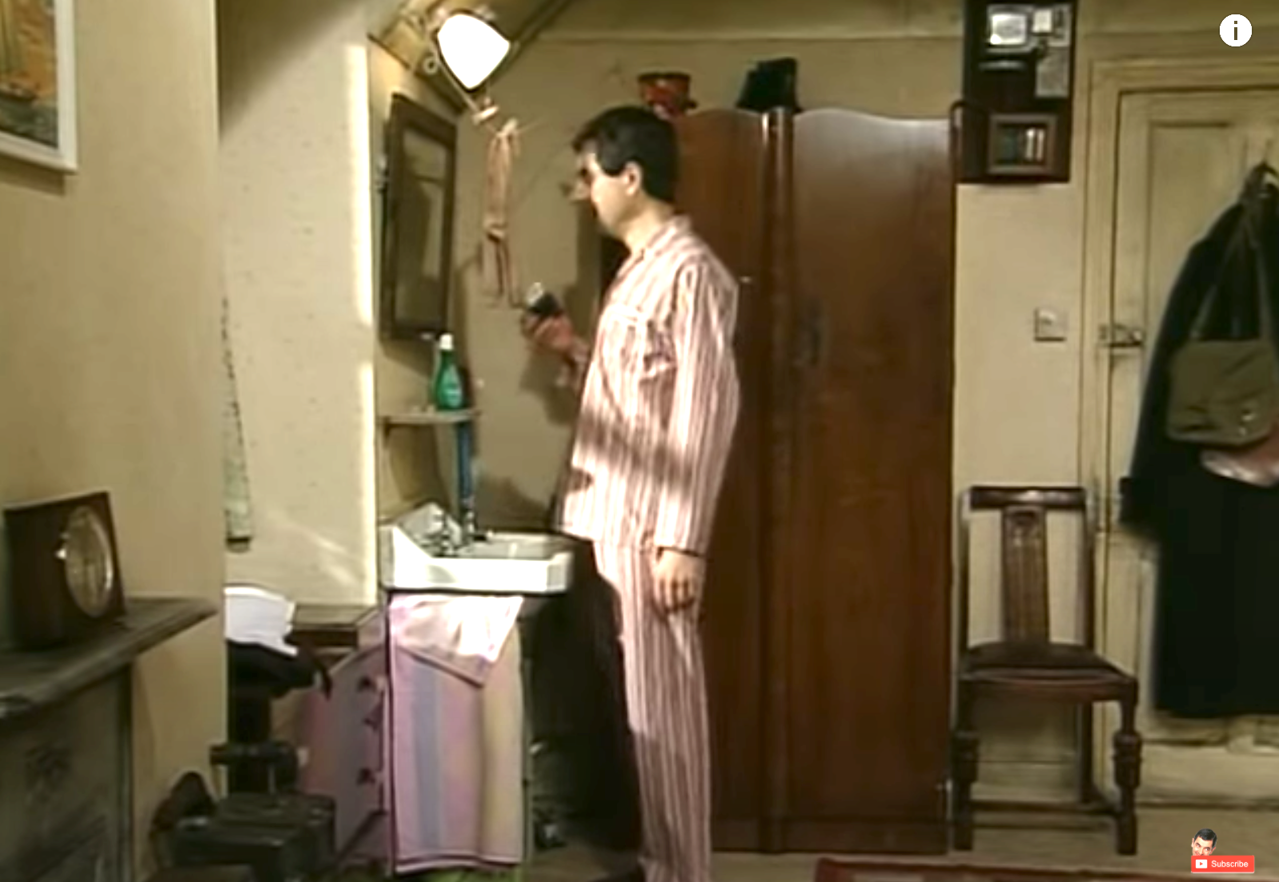
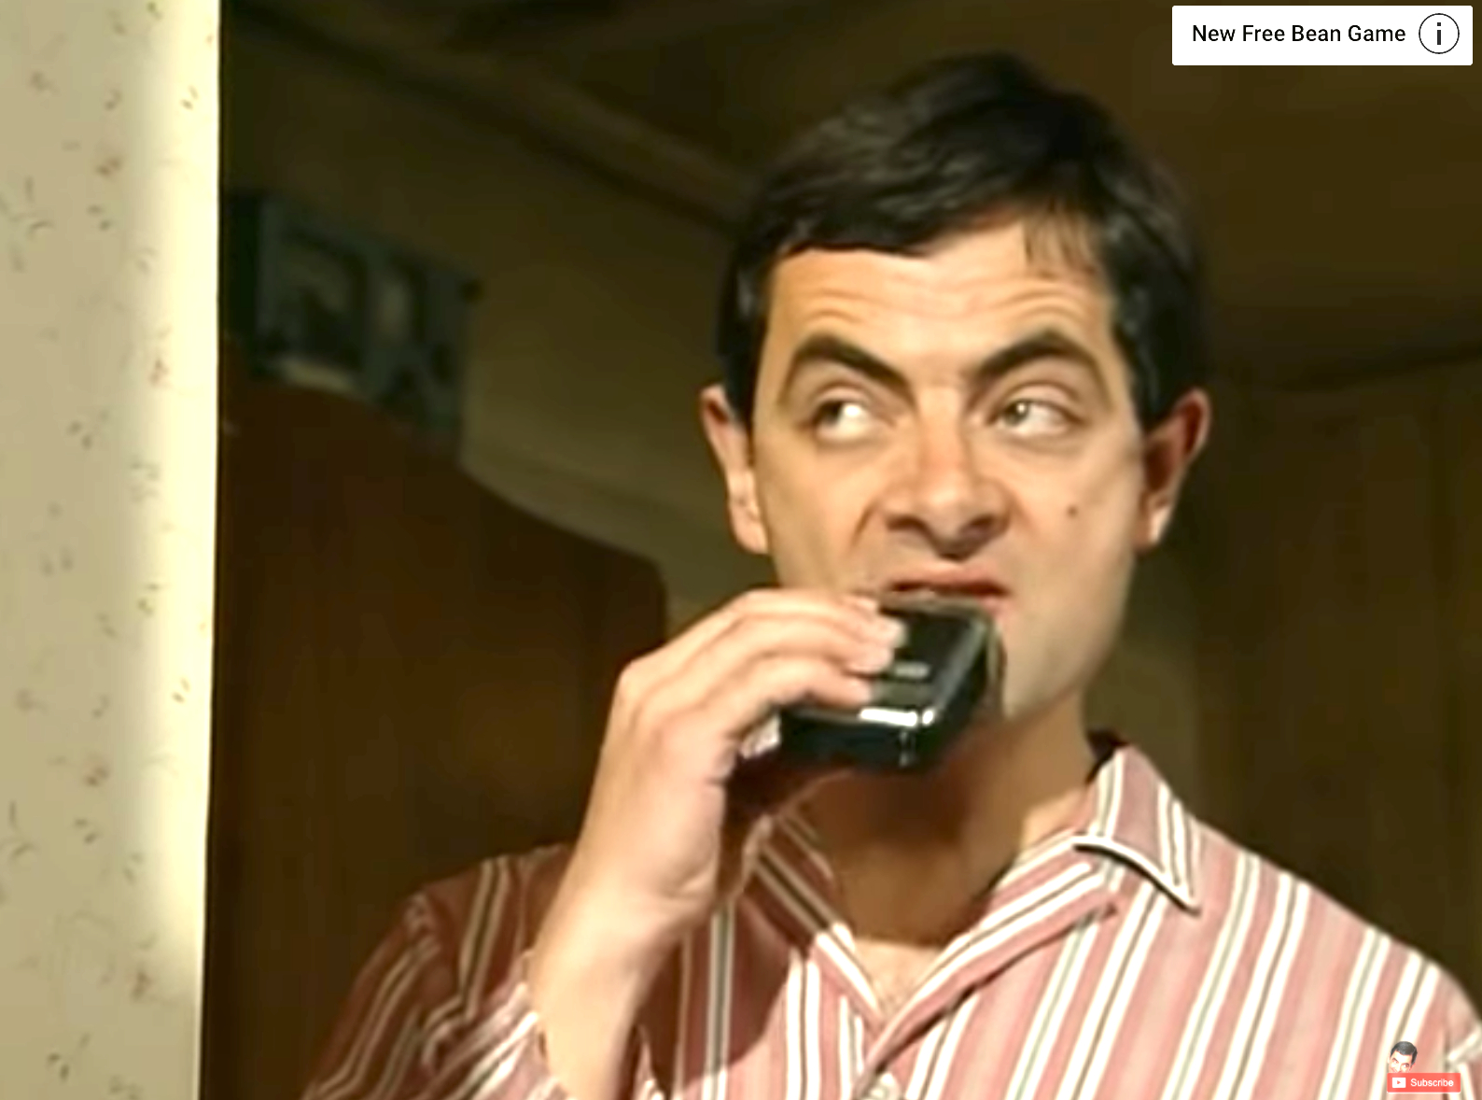
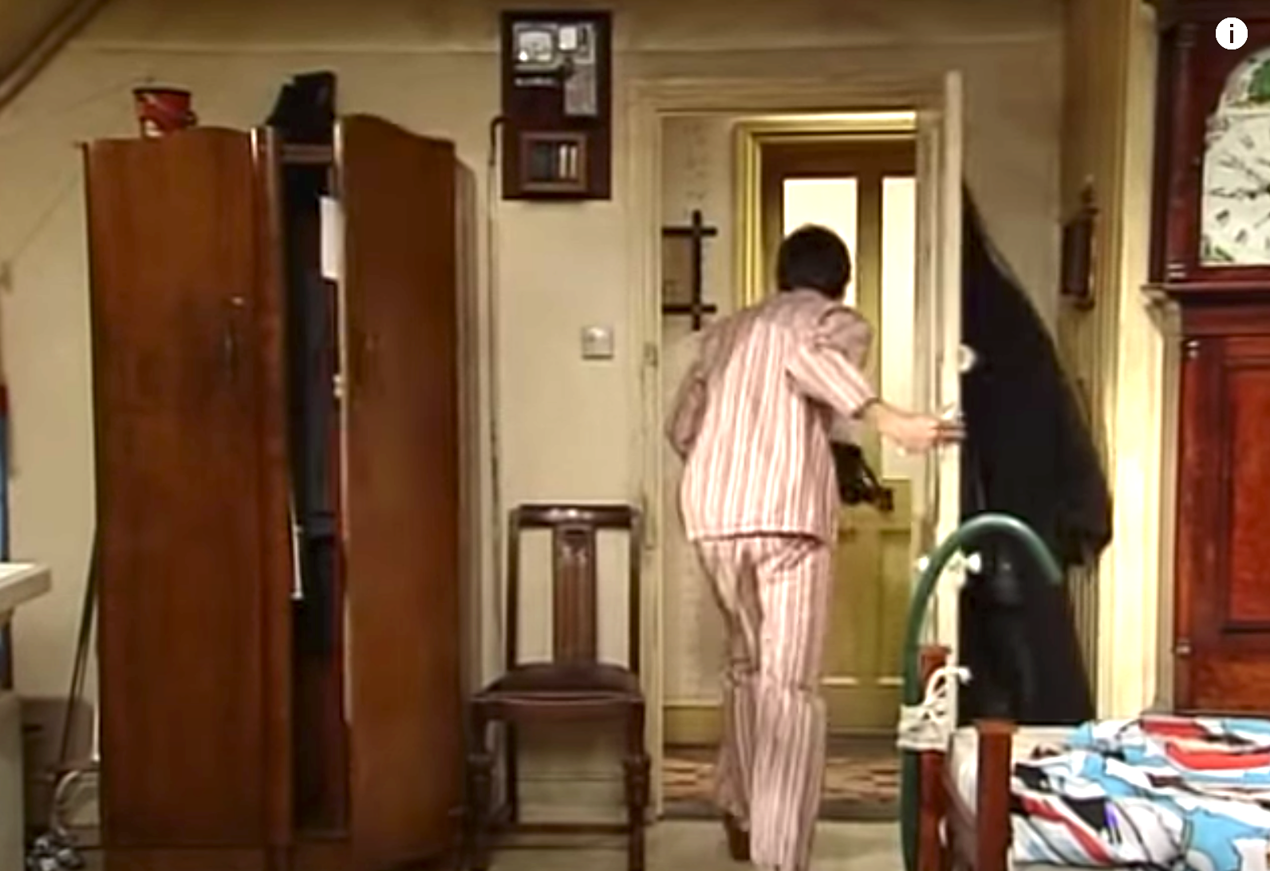
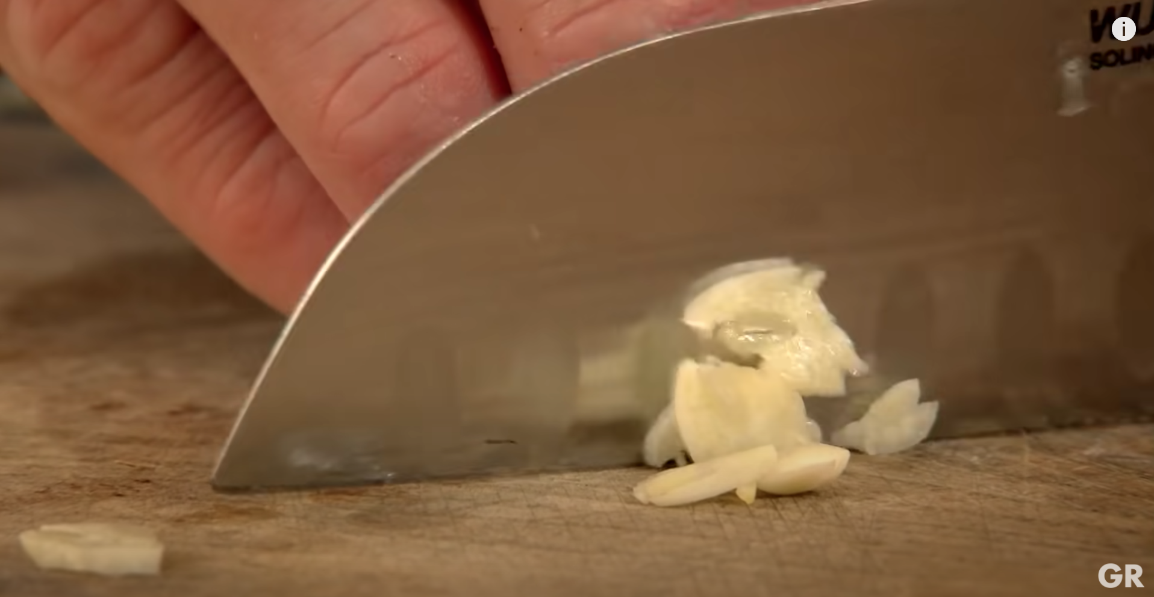
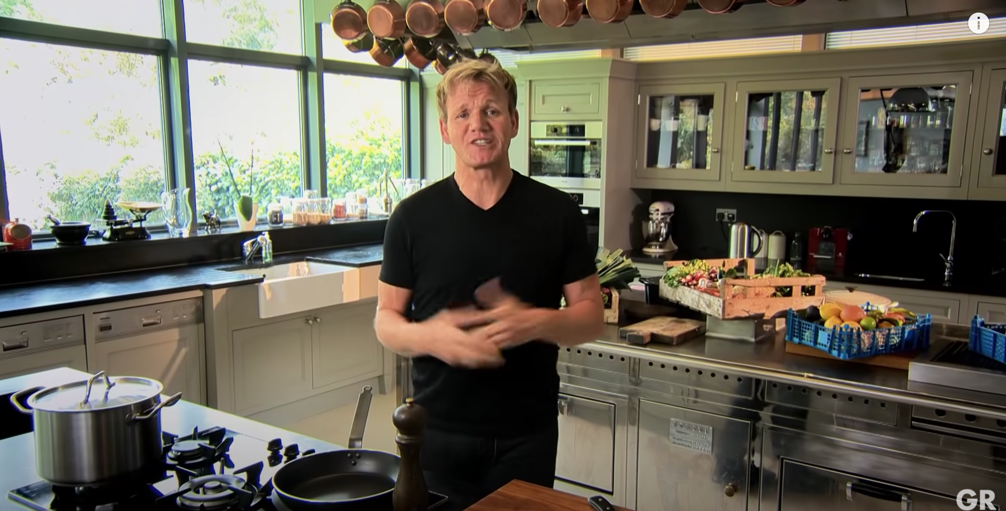
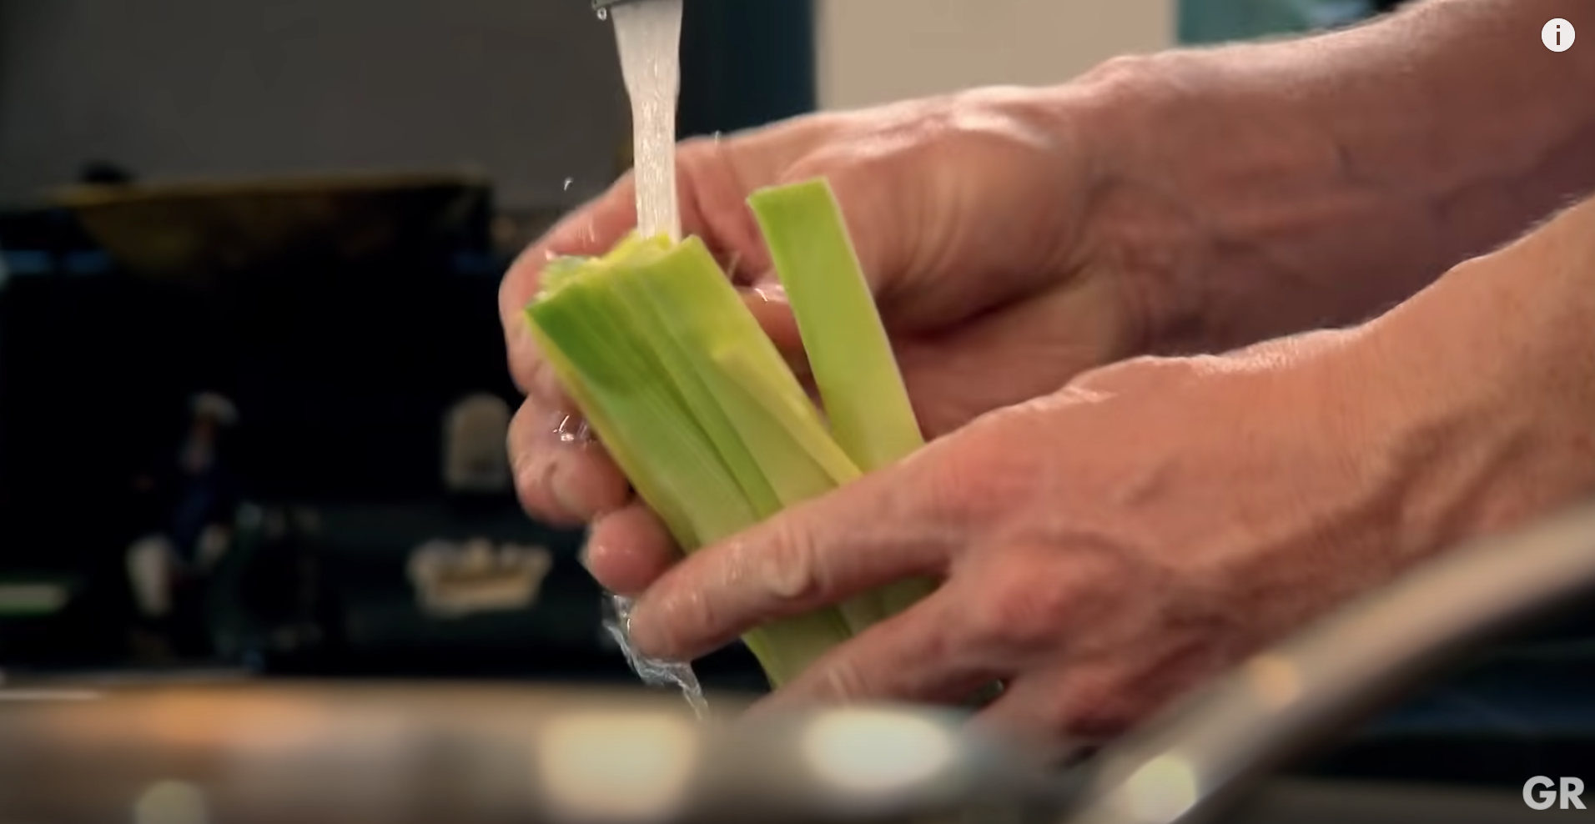
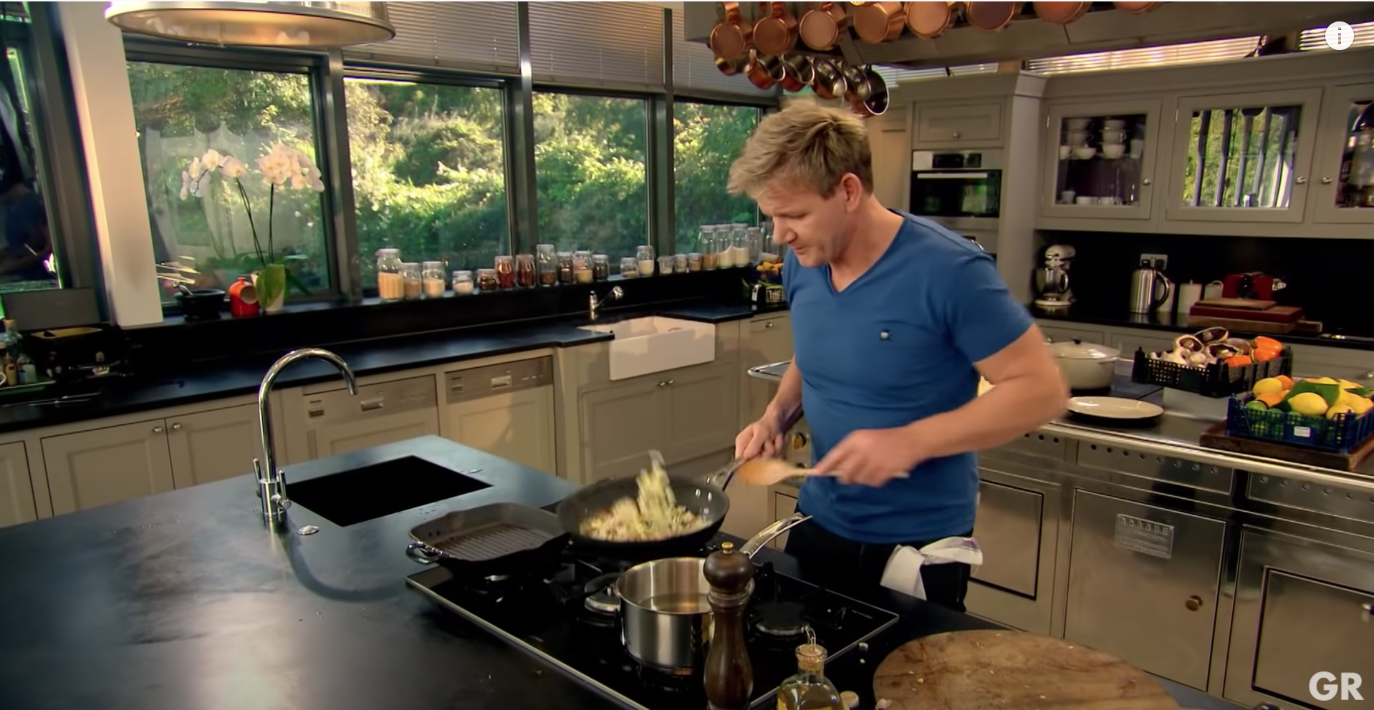
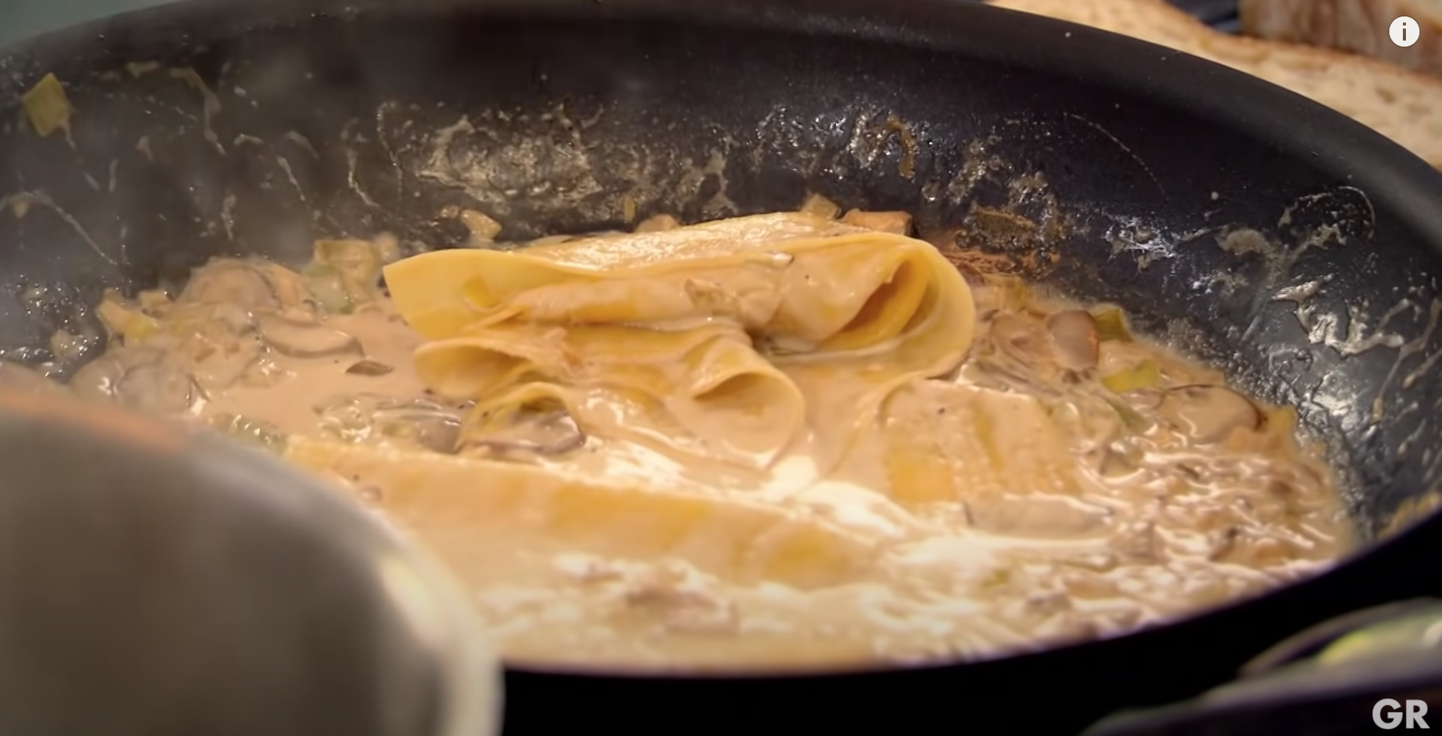
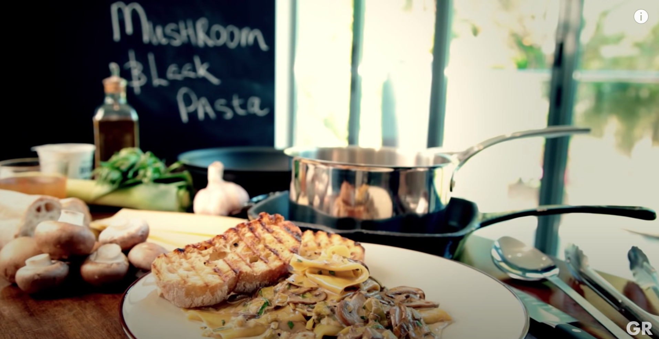
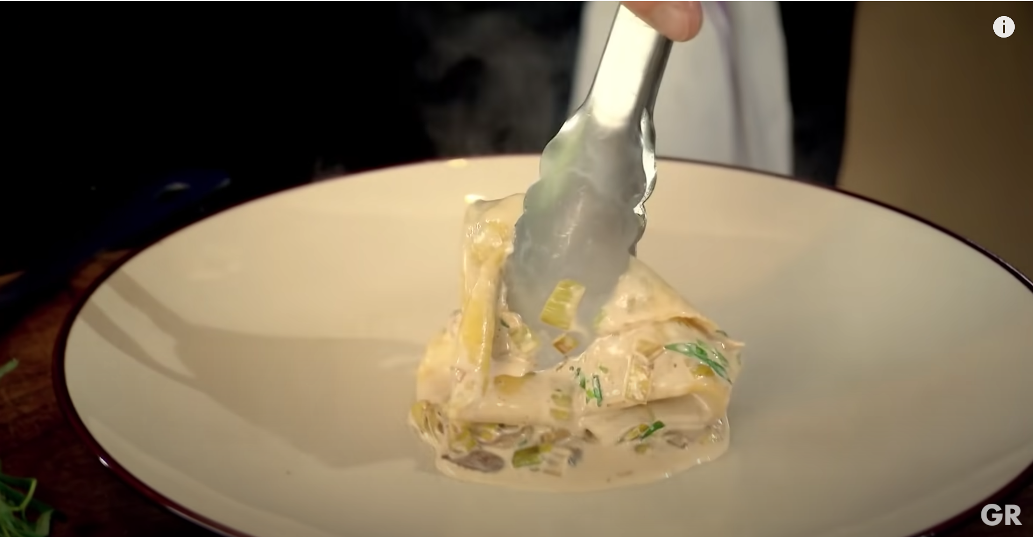
Target Tasks and Algorithms
Temporal Activity Localization (TAL):
On ActivityNet
On THUMOS14
Action Proposals Generation (Proposals):
On ActivityNet
Dense Video Captioning (Dense-Captioning):
On ActivityNet-Captions
TAL
Running
Jumping
Proposals
0.7
0.8
0.5
0.3
0.7
Dense-Captioning
A man is cutting an onion
The cook is serving the plates
He is washing vegetables
The pasta is simmering in the sauce

Slide 11
Target Tasks and Algorithms
Temporal Activity Localization (TAL):
On ActivityNet: G-TAD and BMN
On THUMOS14: P-GCN and G-TAD
Action Proposals Generation (Proposals):
On ActivityNet: BMN
Dense Video Captioning (Dense-Captioning):
On ActivityNet-Captions: BMT
TAL
Running
Jumping
Proposals
0.7
0.8
0.5
0.3
0.7
Dense-Captioning
A man is cutting an onion
The cook is serving the plates
He is washing vegetables
The pasta is simmering in the sauce

Slide 12
Experiments

Slide 13
Ablation Studies Setup

Slide 14
Ablation Studies Setup
Target tasks
TAL
Proposals
Dense-Captioning

Slide 15
Ablation Studies Setup
Target tasks
TAL
Proposals
Dense-Captioning
Encoder architectures
ResNet3D-18
R(2+1)D-18
R(2+1)D-34

Slide 16
Ablation Studies Setup
Target tasks
TAL
Proposals
Dense-Captioning
Encoder architectures
ResNet3D-18
R(2+1)D-18
R(2+1)D-34
Localization algorithms
G-TAD vs. BMN
P-GCN vs. G-TAD

Slide 17
Ablation Studies Setup
Target tasks
TAL
Proposals
Dense-Captioning
Encoder architectures
ResNet3D-18
R(2+1)D-18
R(2+1)D-34
Localization algorithms
G-TAD vs. BMN
P-GCN vs. G-TAD
Pretraining datasets
ActivityNet
THUMOS14

Slide 18
Ablation Studies Setup
Target tasks
TAL
Proposals
Dense-Captioning
Encoder architectures
ResNet3D-18
R(2+1)D-18
R(2+1)D-34
Localization algorithms
G-TAD vs. BMN
P-GCN vs. G-TAD
Pretraining datasets
ActivityNet
THUMOS14
Baselines: TAC on Kinetics / TAC on ActivityNet / TAC on THUMOS14

Slide 19
Study 1: Effects of TSP on Target Tasks
[goal]
Does TSP generalize to different target tasks?
[setup]
Encoder: R(2+1)D-34
Algorithms: G-TAD, BMN, and BMT

Slide 20
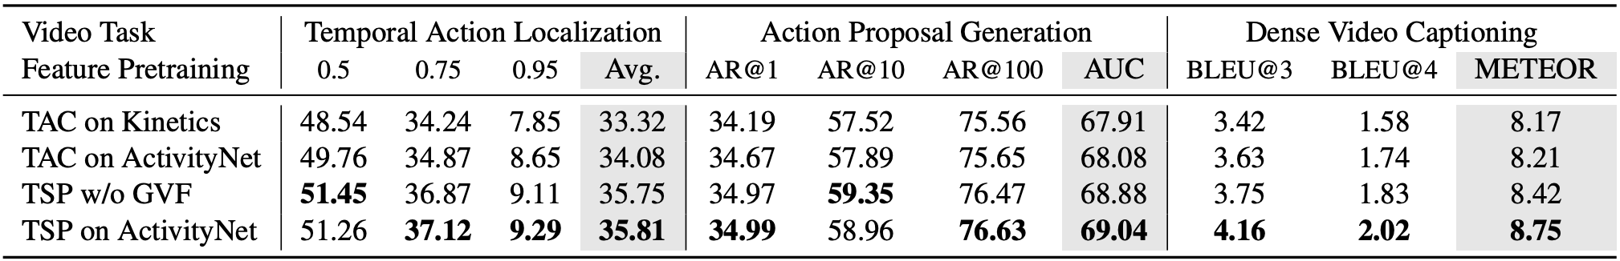
Study 1: Effects of TSP on Target Tasks
[goal]
Does TSP generalize to different target tasks?
[setup]
Encoder: R(2+1)D-34
Algorithms: G-TAD, BMN, and BMT
[results]
TSP significantly outperforms TAC baselines on all tasks

Slide 21
Study 2: TSP for Different Video Encoders
[goal]
Does TSP generalize to different encoders?
[setup]
Task: TAL on ActivityNet
Algorithm: G-TAD

Slide 22
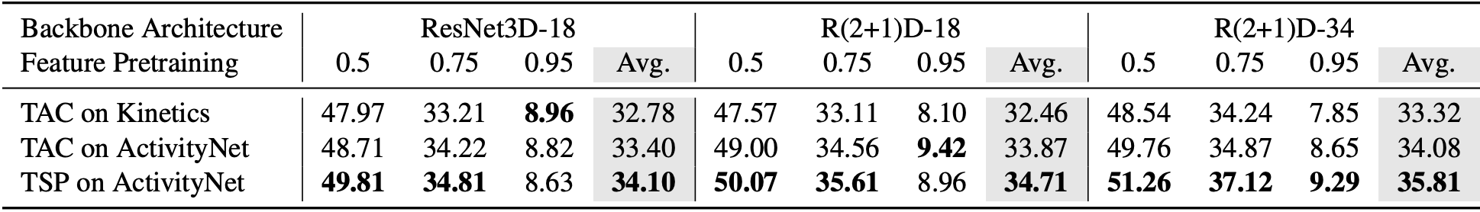
Study 2: TSP for Different Video Encoders
[goal]
Does TSP generalize to different encoders?
[setup]
Task: TAL on ActivityNet
Algorithm: G-TAD
[results]
TSP significantly outperforms TAC baselines for every encoder

Slide 23
Study 3: TSP with Other Localization Algorithms
[goal]
Does TSP generalize to different localization algorithms?
[setup]
Task: TAL on ActivityNet
Algorithm: BMN instead of G-TAD

Slide 24
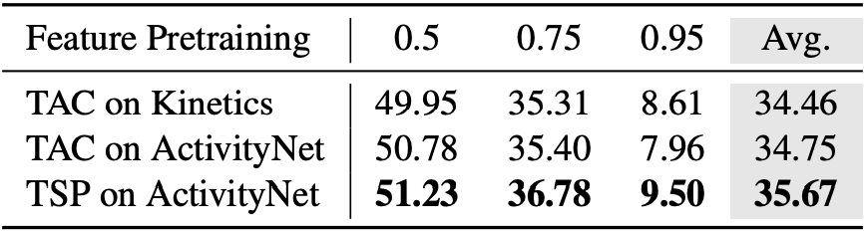
Study 3: TSP with Other Localization Algorithms
[goal]
Does TSP generalize to different localization algorithms?
[setup]
Task: TAL on ActivityNet
Algorithm: BMN instead of G-TAD
[results]
TSP features show the best performance with BMN as well

Slide 25
Study 4: TSP on Different Datasets
[goal]
Does TSP generalize to different datasets?
[setup]
Task: TAL on THUMOS14
Algorithms: PGCN and G-TAD

Slide 26
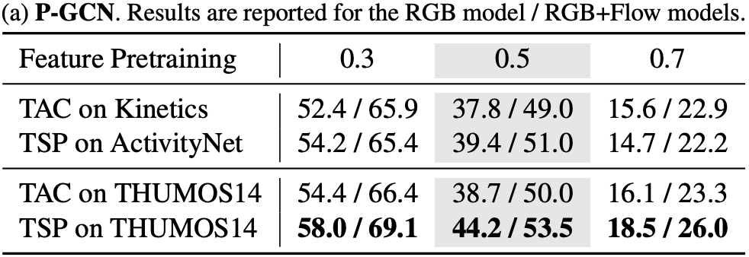
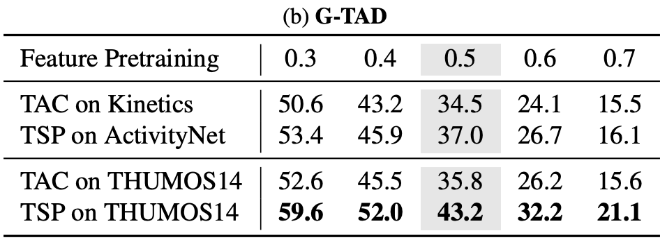
Study 4: TSP on Different Datasets
[goal]
Does TSP generalize to different datasets?
[setup]
Task: TAL on THUMOS14
Algorithms: PGCN and G-TAD
[results]
TSP is transferable across datasets

Slide 27
State-of-the-art Comparison

Slide 28
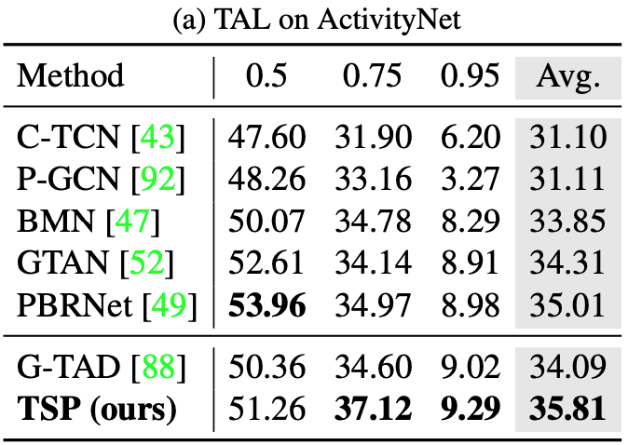
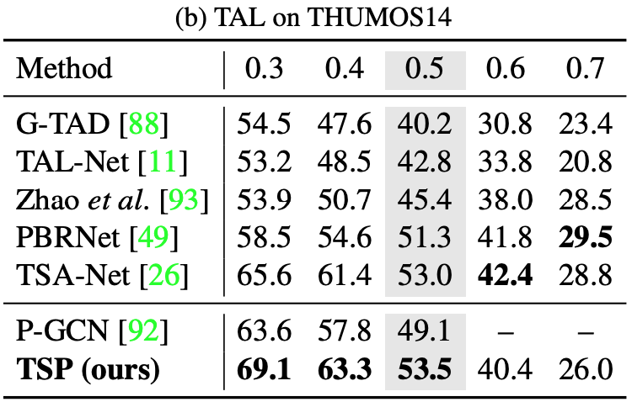
TAL on ActivityNet and TAL on THUMOS14

Slide 29
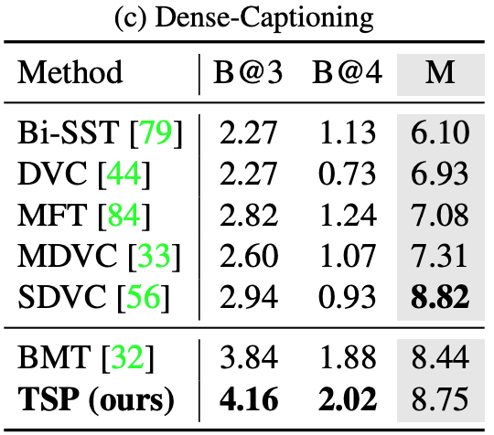
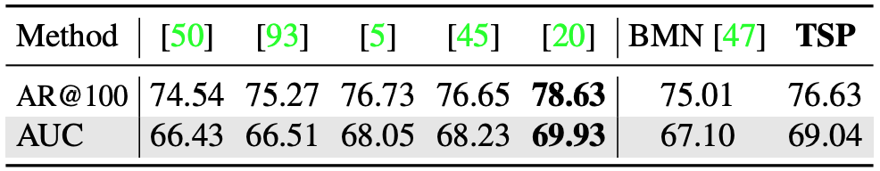
Proposals and Dense-Captioning
* Note that SDVC [56] optimizes for the METEOR with reinforcement learning, which results in lower performance in BLEU relative to SOTA

Slide 30
Analysis

Slide 31
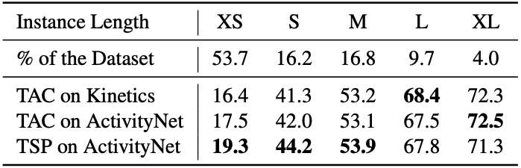
DETAD Analysis
TSP performs significantly better on the Extra Short (XS) and Short (S) actions.
TSP allows localization algorithms to draw sharper boundaries and detect shorter actions better.

Slide 32
Feature Similarity
TSP differentiates foreground from background clips.
TAC on Kinetics
TSP on ActivityNet
The feature similarity matrices for clips in a single video. The green lines represent the temporal extent of ground truth actions.

Slide 33
Feature Similarity
TSP differentiates foreground from background clips.
TSP homogenizes the similarity between action features
TAC on Kinetics
TSP on ActivityNet
The feature similarity matrices for clips in a single video. The green lines represent the temporal extent of ground truth actions.

Slide 34
Feature Similarity
TSP differentiates foreground from background clips.
TSP homogenizes the similarity between action features
TSP increases the differences between background and foreground features.
TAC on Kinetics
TSP on ActivityNet
The feature similarity matrices for clips in a single video. The green lines represent the temporal extent of ground truth actions.

Slide 35
Feature Similarity
TSP differentiates foreground from background clips.
TSP homogenizes the similarity between action features
TSP increases the differences between background and foreground features.
TSP learns dissimilarities between background and foreground.
TAC on Kinetics
TSP on ActivityNet
The feature similarity matrices for clips in a single video. The green lines represent the temporal extent of ground truth actions.

Slide 36
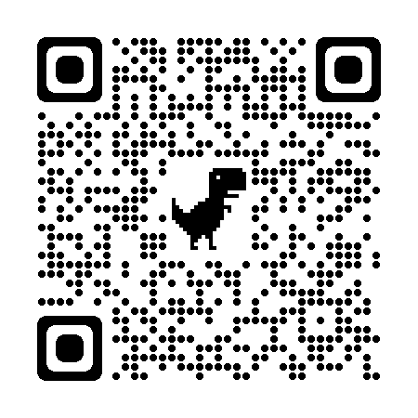
Code, Models, and Features
http://www.humamalwassel.com/publication/tsp/

